Slide 1
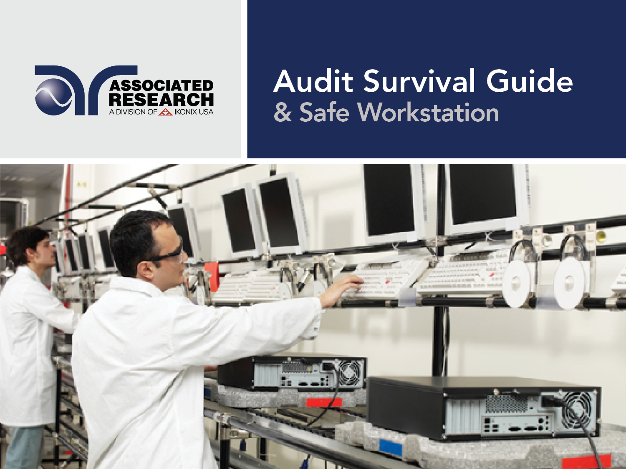

Slide 2


Slide 3
Webinar Notes
  Please use the Q & A utility to ask us any questions concerning
  the material being presented.
  Please contact Brittany Socha- chat line or email brittany.socha@arisafety.com if you would like a copy of the presentation.

Slide 4
Audit Survival Guide – Learning Objectives
How can we help?
Be prepared
Surviving the Audit
Instrument Verification and Calibration
Qualification (IQ/OQ)
What are Auditors looking for?
Safety of test stations and safe work practices (OSHA)
TVB-2 and LVB-2
Accredited Calibration
Software Validation – Data capture and collection
Applications Consultation Services
Safe Workstation - OSHA

Slide 5
Getting Audited
Auditors from different agencies look for different items
An auditor from UL may look for the following:
Production Capacity, Process Controls, Material Parameters
Preventative Maintenance & Rework
Assembly Process, Storage and Handling,
An auditor from OSHA will look for the following:
Automation and Software validation
Instrument, Operation and Performance Qualification (IQ, OQ & PQ)
Safety in general (safety procedures and safe work practices)
Safe workstation
Use of PPE’s

Slide 6
Getting Audited
Electrical Safety Test setup and procedure can be very complex
Everything must be in accordance with standards/safety guidelines
Equipment Validation
Operator Education
Software Validation

Slide 7
Getting Audited
Key Words | Importance | Implications for Failure
Safety | OSHA guidelines and European Norm standards dictate safe work practice | Fines, litigation, possible injury or fatality.
Validation | Ensure a system is functioning with stated specifications. | Products not properly tested. Possible product recall.
Education | Proper testing protocols. | Lose safety mark, product recall, possible litigation (if end user injured).

Slide 8
QUIZ QUESTION

Slide 9
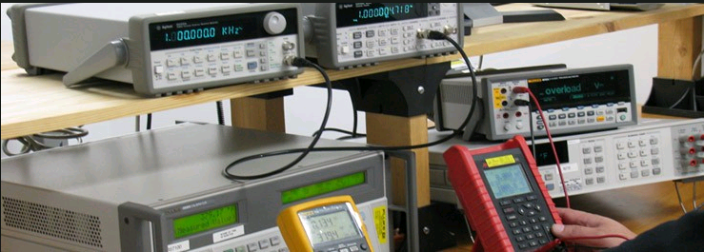
Calibration
Verifies if an test instrument is functioning properly and within specification
We recommend annual calibration (some go with 6 month)
Calibration Certificate, before and after data
Accredited Calibration with measurement data and uncertainty traceable to NIST
Associated Research offers the following: ISO 17025, ANSI Z540.1-1994, CTL Specification Sheet DSH 251B, Denan’s Law
Copyright 2017 Associated Research

Slide 10
Instrument Verification
An electrical safety test is only as good as the test instrument
Simple way of checking if the failure detectors are working correctly
Recently, test standards have started to mention the importance of instrument verification
Some manufacturers perform instrument verification daily or before very shift
Associated Research offers solutions for verification of different test types
Test Verification Boxes: TVB-2 and LVB-2
Copyright 2017 Associated Research

Slide 11
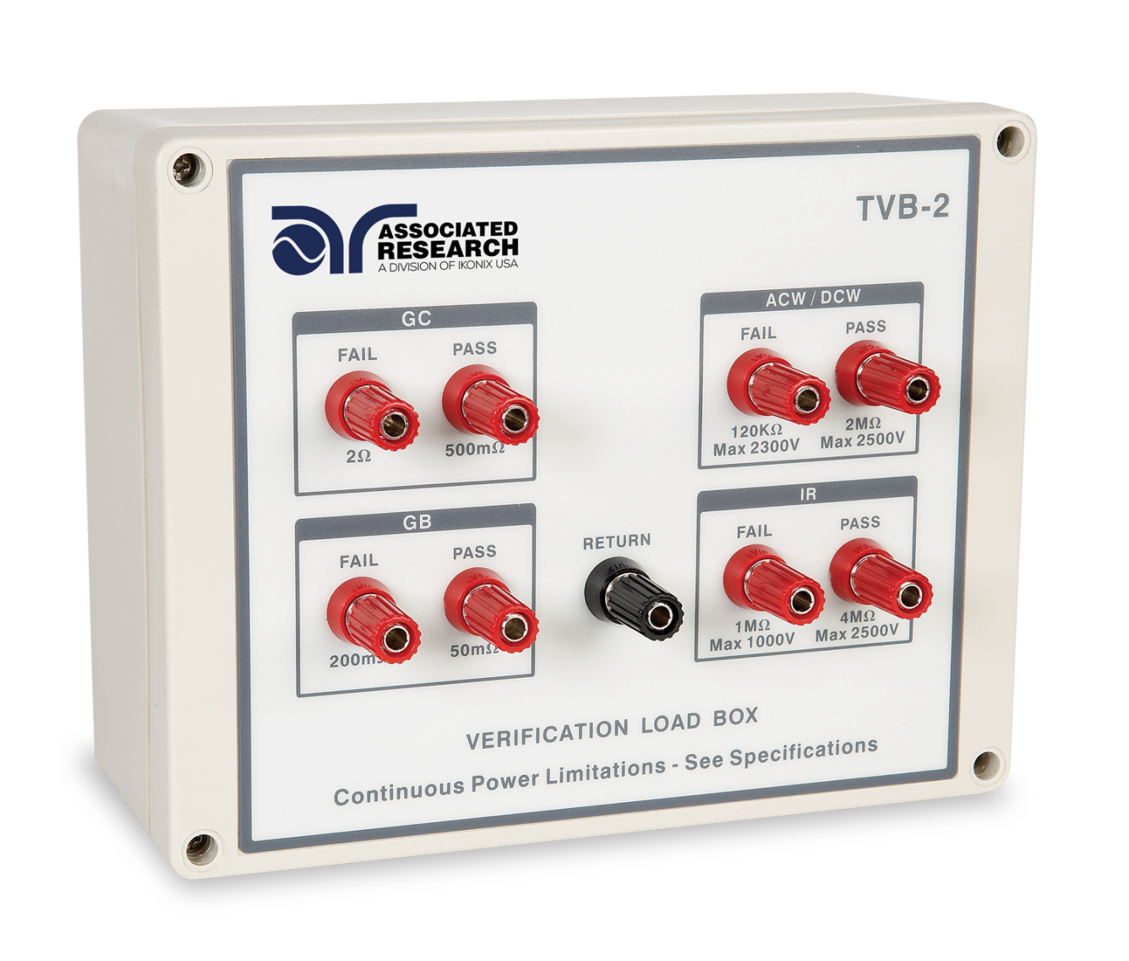
Instrument Verification – TVB-2
Ground Bond/Continuity
ACW/DCW
Insulation Resistance
Pass/Fail Verification
CE listed
Copyright 2017 Associated Research

Slide 12
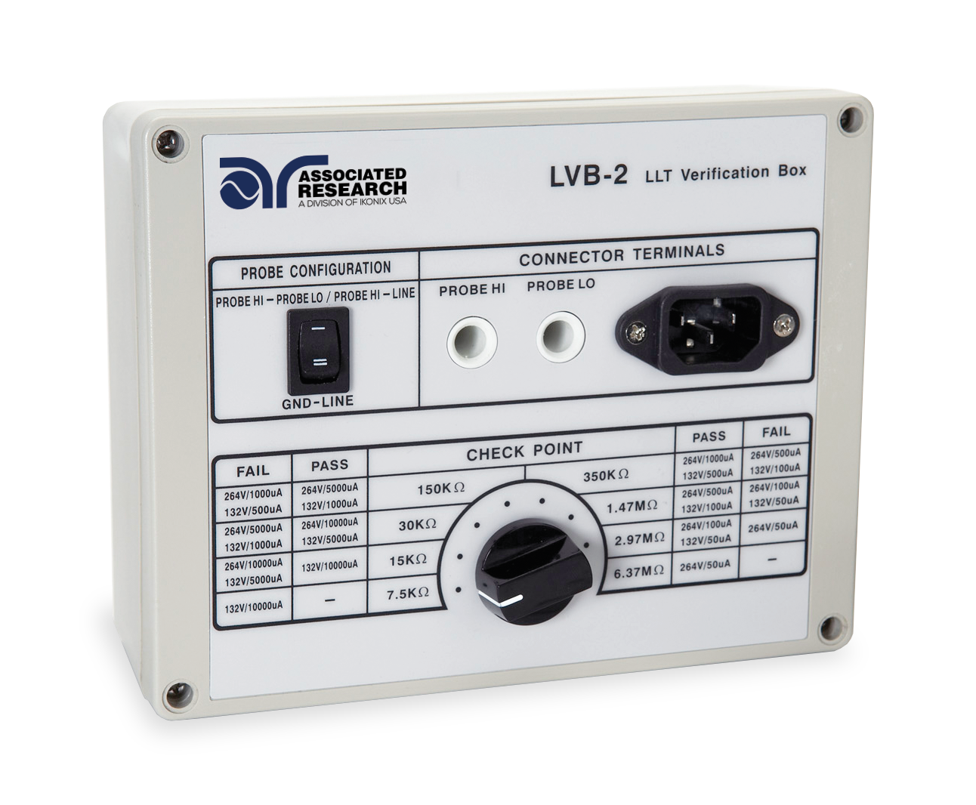
Instrument Verification – LVB-2
Leakage Current Test Verification
Various types of LCT’s
Multiple Loads
CE Listed
Copyright 2017 Associated Research

Slide 13
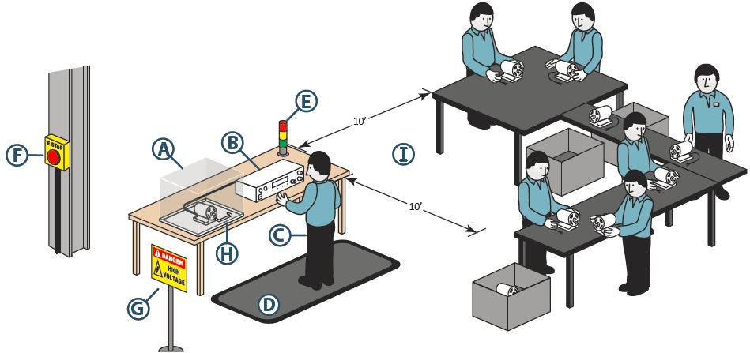
Safe Workstation
Utilizing safe workstations & work practices is essential to operator safety
An auditor may want to make sure all the necessary safety precautions are in place
There are standards in place that focus primarily on setting up safe workstations (OSHA 1910 Subpart S)
Associated Research provides training and recommendations based on guidelines from the standards
Copyright 2017 Associated Research

Slide 14
Safe Work Practices
All manufacturers must implement internal safety procedures
Associated Research product manuals contain all the necessary warnings and cautions for user protection
It is the responsibility of an organization to implement and enforce safe work practices and provide all the necessary PPE
Selection and use of work practices 1910.333 - "General." Safety-related work practices shall be employed to prevent electric shock or other injuries resulting from either direct or indirect electrical contacts, when work is performed near or on equipment or circuits which are or may be energized. The specific safety-related work practices shall be consistent with the nature and extent of the associated electrical hazards
Copyright 2017 Associated Research

Slide 15
Qualification Procedures
Integral part of any organization when they acquire new test instruments
These procedures are normally very detail oriented and time consuming
Organizations performing these procedures look for help from instrument manufacturers as their best resource
Associated Research can help customers with these procedures
With our Consultation Program we can assist our customers with their qualification procedures
As the manufacturer, we are the best resource when it comes to our instruments
We can help make your IQ, OQ and PQ simple
Copyright 2017 Associated Research

Slide 16
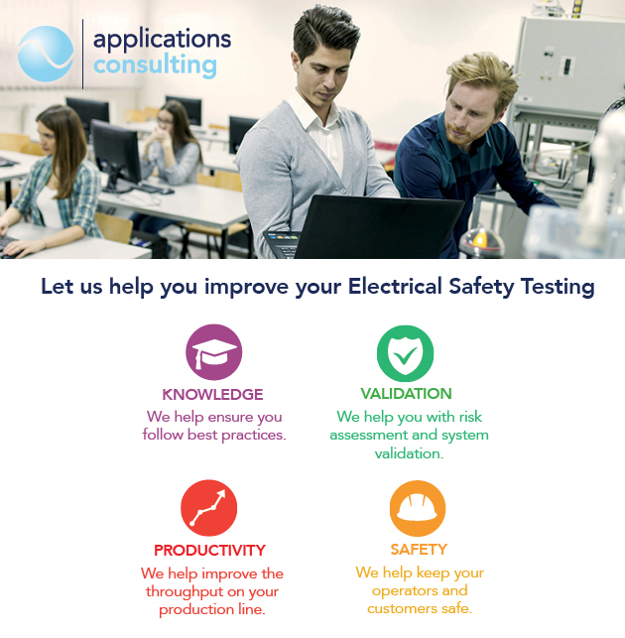
Applications Consulting

Slide 17




We give our customers confidence that their
system is SAFE and EFFECTIVE
Key Words | Importance | Implications for Failure
Safety | OSHA guidelines and European Norm standards dictate safe work practice | Fines, litigation, possible injury or fatality.
Validation | Ensure a system is functioning with stated specifications. | Products not properly tested. Possible product recall.
Education | Proper testing protocols. | Lose safety mark, product recall, possible litigation (if end user injured).
Productivity | Improve automation efficiency and production volume. | Longer test time and less throughput.
Increase Productivity

Slide 18
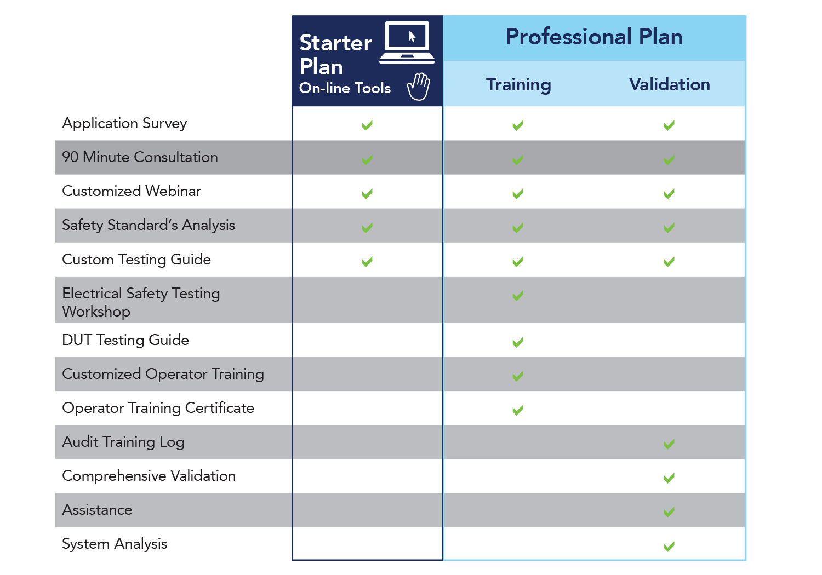
Applications Consulting

Slide 19
POLL QUESTION

Slide 20

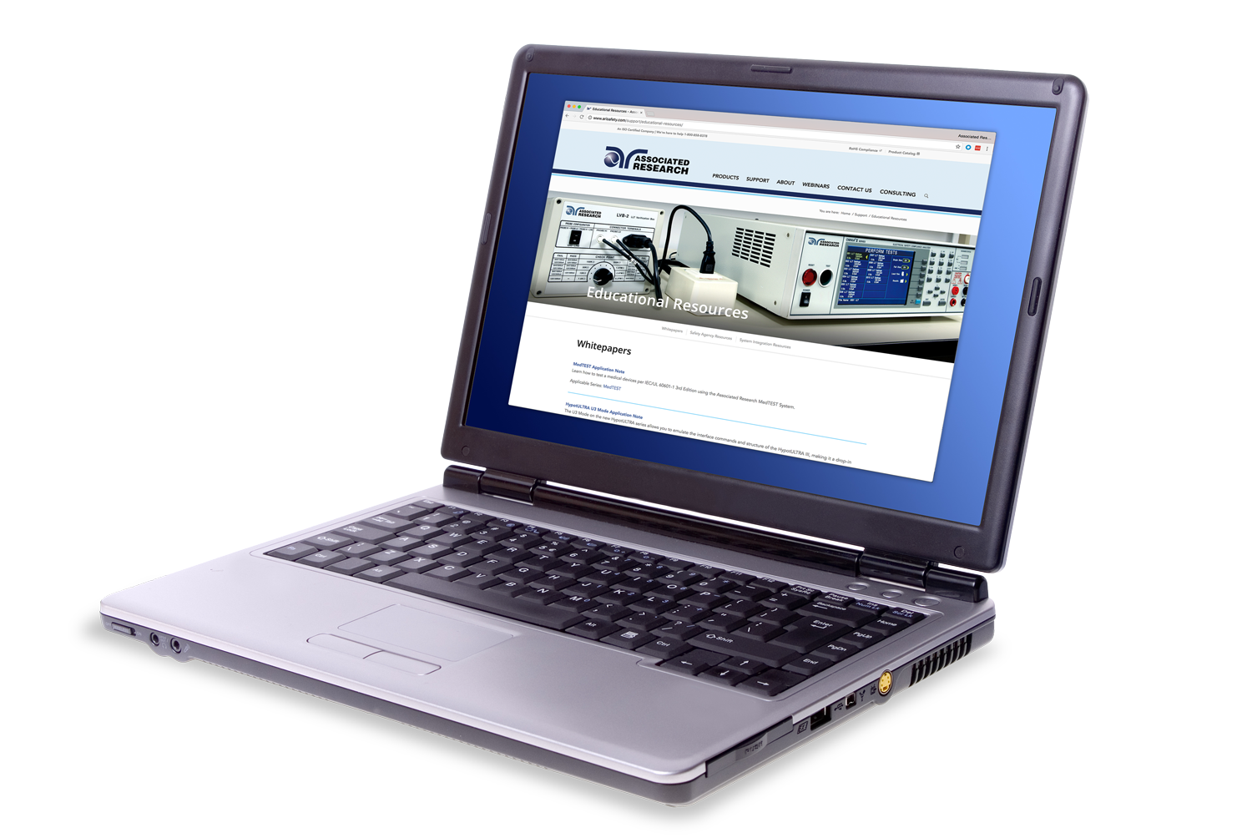
Resources
Visit us online to view all of our Educational Resources:
http://www.arisafety.com/support/educational-resources/

Slide 21
JOIN US FOR OUR
NEXT WEBINAR
Wednesday, September 13 10 am CST (3 PM GMT)
Leakage Current Testing 101
Click the link in chat box to learn more

Slide 22

Contact Us
If you would like a copy of this presentation please email Brittany Socha at brittany.socha@arisafety.com
Check out our website for more information arisafety.com

